Slide 1
Aging & DISABILITY SERVICES
Draft Area Plan On Aging
2016-2019
Presentation to Seattle Planning Commission
September 10, 2015
Maureen Linehan, Director
Ava Frisinger, Advisory Council Chair

Slide 2
ADS Mission
To develop a community that promotes
quality of life, independence and choice for
older people and adults with disabilities
in King County.

Slide 3
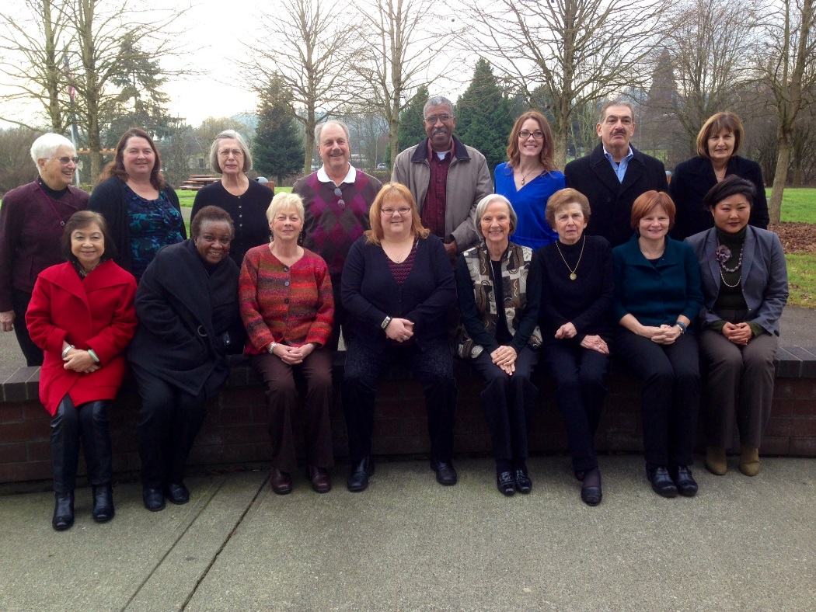
Area Agency on Aging
Chartered under the Older Americans Act
629 AAAs in the U.S. (N4A)
13 AAAs in WA state (W4A)
ADS Sponsors: Seattle Human Services Dept, King County, and United Way of King County
27-member Advisory Council
Notes:
AAA – planning, coordination responsibilities
Could be where Ava comments

Slide 4
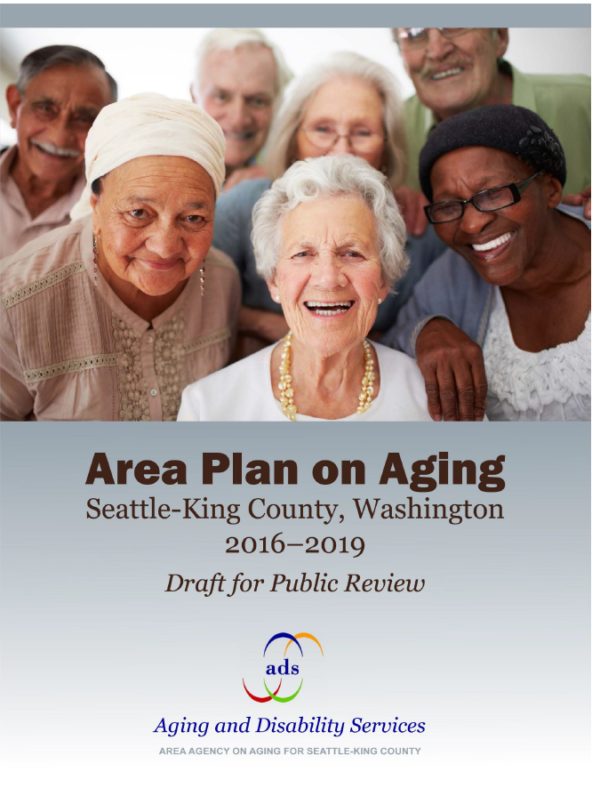
What is the Area Plan on Aging?
Based on community input process
Will guide ADS work from 2016 to 2019
Highlights goals for developing age-friendly communities
Summarizes annual budget of $38 million in federal, state and local resources
Updated every two years
Notes:
Our community needs assessment for adults and caregivers facing aging and disability issues.

Slide 5
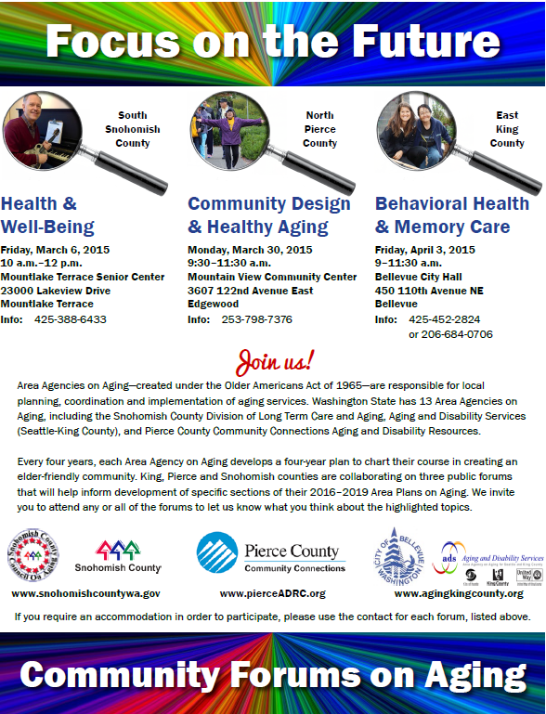
Area Plan Input
ADS sought input for the Area Plan during 2014 to 2015
2014 Community Outreach and Engagement.
2015 Area Plan Online Survey
2015 Focus on the Future Forums on Aging
Notes:
We sought input for the plan…
During 2014, we solicited input from agencies and individuals across King County, including senior centers, family caregivers, cultural groups, including immigrant and refugee communities, and advocates for people with disabilities. The feedback was used to inform two Request for Investment processes in 2015, as well as the Area Plan.
We launched an on-line questionnaire from January to March and about 580 individuals completed it on-line. About 60% were age 60 to 74.
We also co-hosted three community forums with Pierce, Snohomish AAAs and with the City of Bellevue Human Services. Over 100 people participated in the forums.
In addition, we also:
Held community conversations with the Seattle Commission for People with Disabilities and the Feet First Board of Directors.
In February we hosted a premiere screening of a documentary we created about the evolution of aging services in the Seattle-King Co. area. Over 80 people attended and, at the end, provided input about the needs of older adults and people with disabilities.
We participated in the Alzheimer’s Disease Working Group and in the Community Listening Sessions.
ADS staff and Advisory Council members participated in the White House Conf. on Aging.
ADS co-sponsored a town hall meeting, that focused on LGBTQ elders, along with the University of WA. and other LGBTQ groups.

Slide 6
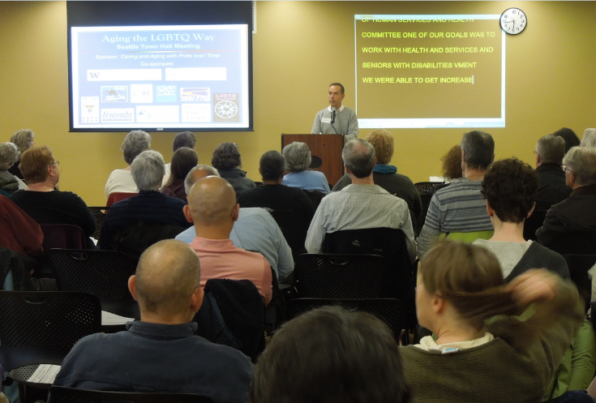
What We Heard: Top Needs/Concerns
Older adults
  Housing
  Health/health care
  Transportation
  Safety
People with Disabilities
  Transportation
  Health/health care
  Socialization
Notes:
Refer to the community engagement materials for more details on housing, transp and safety.
For Housing affordability and repairs were big – as was access
Health and Healthcare were the top “dot getters” at one of the forums. Access is a big issue and that has to do with integration – different parts not talking to each other. Anecdotally, oral health is a big unmet need. Staying healthy also big concern.
Other priority populations’ had more specific needs / concerns:
Example for LGBTQ
Sensitivity training for medical and social service providers
A community center dedicated to LGBTQ elders
Support for transgender older adults

Slide 7
What’s in the Area Plan?
Agency organizational structure, annual budget and service delivery system
Demographic trends, community needs and best practice research
Goals and objectives to address issues and areas of concern identified by the community and other stakeholders
Notes:
The Area Plan is a guide to help us meet the challenges and opportunities that are before us.
Area Agencies are instructed by the State about what to include in our Area Plans.
However, each plan is unique in that it reflects the needs of older adults and adults with disabilities, specific to the county (or counties) the AAA represents.
Four main sections include:
Section A: Area Agency Planning &Priorities
Section B: Planning and Service Area Profile
Section C: Issue Areas, Goals and Objectives
Section D: Area Plan Budget

Slide 8
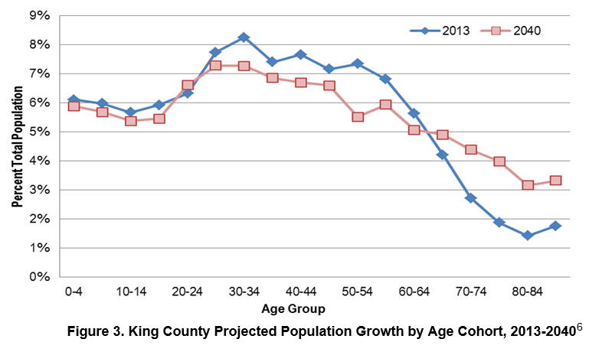
King County 60+ Population
Notes:
Skip over or re-iterate Linda’s presentation.
The plan includes a population profile, including this slide that illustrates:
Current population projections – This slide shows how King County’s 60 and older population will be about 25 percent of the total population by 2040.
It also shows the fastest-growing segment of the total population is the oldest old—those 85 and over.
The red boxes/line represent 2040 projections

Slide 9
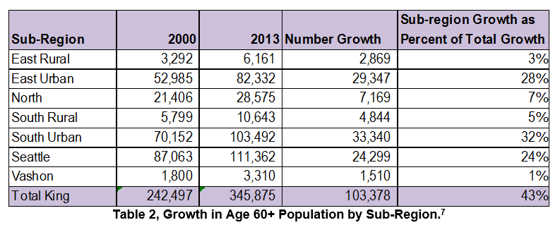
60+ Growth, by King Co. Sub-Region
Notes:
This table indicates that about 80% of the growth in King Co. of the 60 and older population occurred in Seattle, South Urban and East Urban sub-regions.

Slide 10
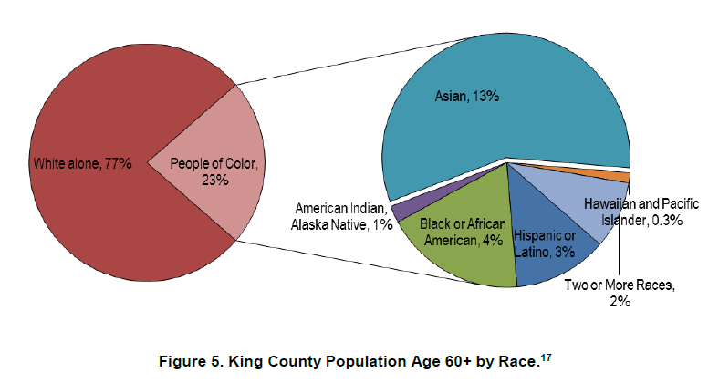
Diversity Among 60+ Population
Notes:
This chart shows how diverse the older adult population is in King County.
About 23 percent of King County’s population are people of color, a four percent increase since 2011.
Much of the diversity is due to increases in the immigrant and refugee populations.

Slide 11
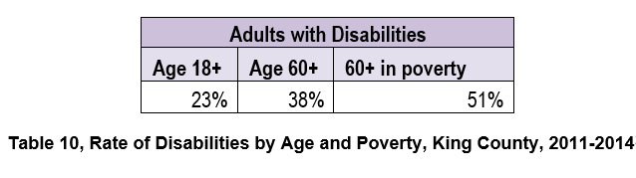
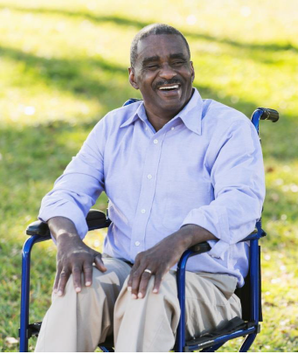
Disability Among 60+ Population
Notes:
As the older individuals live longer with chronic illnesses, they face increased likelihood for acquiring a disability.
In addition, if you are poor and older than 60, your rate of disability is much higher
(Self-reported data)

Slide 12
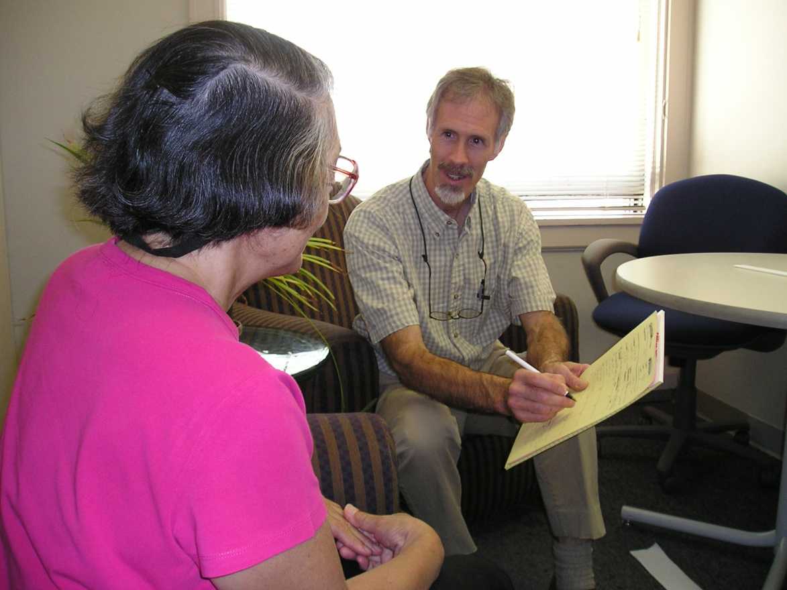
Goals and Objectives
High Quality, Community Based Long Term Care Services and Supports
Improve efficiencies and reduce costs while maintaining a high quality of care for Medicaid Case Management clients.
Advocate for funding to meet the growing demand for services, including the increasing number of vulnerable clients with complex needs.
Notes:
Over the next four years, ADS will focus on five areas. The first four are prescribed by the State. The last one “Age-Friendly Communities” is one that we’ve added and it incorporates much of the input we received from the public and providers.
Long Term Services and Supports
Delay of Medicaid-funded Long Term Services and Support, including Health Promotion and Disease Prevention
Service Integration and Systems Coordination
Older Native Americans, and
Age-Friendly Communities
Issue area 1 – long term services and support are programs to promote independence among older adults and people with disabilities and their caregivers.
In Washington, those that need help remaining independent have a variety of choices. Our state is ranked # 2 behind Minnesota in an AARP scorecard on affordability, quality and choice.
In this issue area, the state asked each AAA to respond to the increase in complex clients and how we will address the rising caseloads with limited resources.
Proposed objectives:
Advocate for full funding to maintain quality in-home case management
Implement operational changes, such as team based staffing approaches, to improve efficiencies and reduce costs.

Slide 13
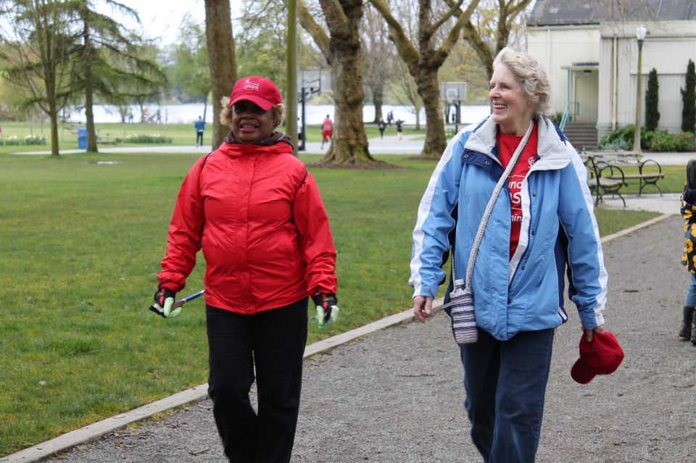
Goals and Objectives
Access to Information and Services to Support Healthy Aging
Provide information and connect older adults, people with disabilities and family caregivers to programs and services that help them stay healthy, active and engaged in their communities.
Notes:
Upstream approaches
Issue Area 2 – pre-Medicaid Services
Program examples:
Family caregiver support program
Community living connection – access and information
Health promotion such as fall prevention and exercise programs
State asked us to:
Develop strategies for continued development and expansion of the family caregiver program and community living connection
Develop strategies to address the growing number of adults with Alzheimer’s and Dementia
Objectives for pre-Medicaid:
2015 RFP for community living connection and family caregiver – over the next 4 years, implementing the model
Training providers on relevant topics such as strategies to meet the needs of LGBTQ elders.
Continue to provide workshops for early stage memory loss
Expand evidence-based health promotion programs

Slide 14
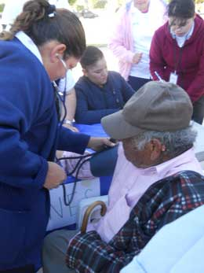
Goals and Objectives
Service Integration & Systems Coordination
Integrate Aging Network services and other human services with medical and behavioral health systems for better health care at a lower cost.
Notes:
Issue 3 – role of the AAA in service (physical and behavioral health) integration efforts and how we can link long-term services and supports with the formal health care delivery systems
Proposed objectives:
Participate in the Accountable Communities of Health – regional approach that focuses on social determinants of health, clinic-community linkages, and whole person care
Coordinate with health system and human services organizations to put on an annual care transitions conference
Participate in multi-stakeholder collaborations that try to improve health outcomes and reduce unnecessary EMS and ED use
Systems coordination is very important for elder justice – we hope to increase access and awareness of elder abuse, neglect, and financial exploitation

Slide 15


Goals and Objectives
Older Native Americans
Ensure greater success for Native American elders in King County.
Notes:
Issue #4 – Older Native Americans
Proposed Objectives:
Strengthen ADS ability to serve community groups that have not been served previously, including urban Native American elders.
Collaborate with federally recognized tribes in King County to create the 7.01 plan
Continue to address objectives in the plan such as case management, training for staff and caregivers on aging and disability issues

Slide 16
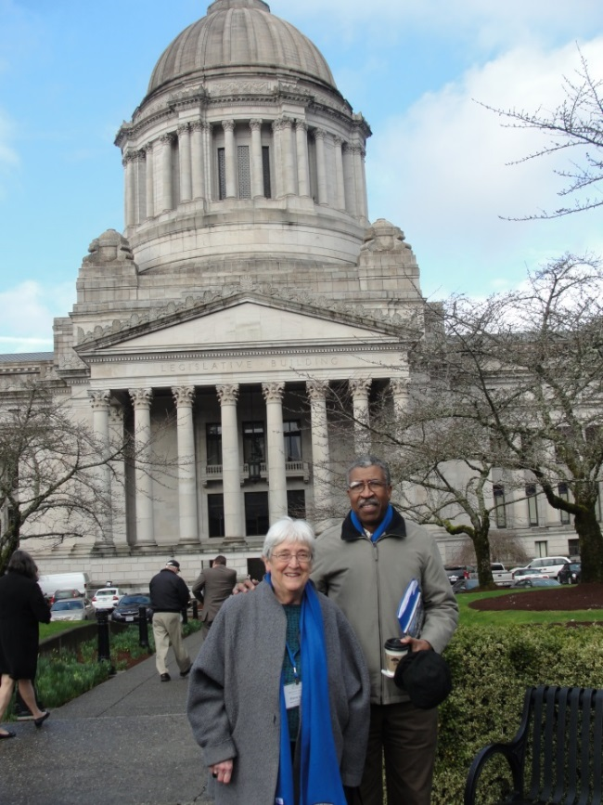
Goals and Objectives
Livable Communities
Engage local governments, decision makers and consumers in preparing for the aging
population, and work across
sectors to make our neighborhoods
and cities great places for people
of all ages.
Notes:
Cross sector work.
Issue #5 – Livable Community – Issue we were able to shape from community input. There are many livable models out there, but we’re leaning toward the World Health Organization framework.
Proposed objectives:
Affordable housing – use our advisory council to advocate for increased funding and encourage development of alternative housing for aging in place
Transportation – advocate to increase availability and also coordinate with others working on transportation for the vulnerable (e.g. Hyde Shuttle)
Social and civic engagement/participation – increased funding for senior centers and related services to reduce social isolation
Senior centers are not only an integral part of the aging network, but trusted and welcoming place to connect older adults with needed services.

Slide 17
Livable Communities
Area Plan Goals
  Affordable And Accessible Housing
  Community Mobility
  Economic Security
  Social and Civic Engagement
Age Friendly Cities / WHO Framework
Notes:
Cross sector work.
Issue #5 – Livable Community – Issue we were able to shape from community input. There are many livable models out there, but we’re leaning toward the World Health Organization framework.
Proposed objectives:
Affordable housing – use our advisory council to advocate for increased funding and encourage development of alternative housing for aging in place
Transportation – advocate to increase availability and also coordinate with others working on transportation for the vulnerable (e.g. Hyde Shuttle)
Social and civic engagement/participation – increased funding for senior centers and related services to reduce social isolation
Senior centers are not only an integral part of the aging network, but trusted and welcoming place to connect older adults with needed services.
The Green Way to Travel in Your Neighborhood (AgeWise King County, May 2015). Seattle Department of Transportation photo. C-5-1: Housing
a. Advocate for increased funding for low-income housing, and to reduce barriers to providing services to older adults in subsidized housing, and encourage development of alternative housing for aging in place.
b. Provide education about the benefits of Universal Design (UD) and promote the inclusion of UD principles in all capital construction programs.

Slide 18

Contact Us
Website: www.agingkingcounty.org
Face Book: www.facebook.com/AgingKingCounty

